Slide 1


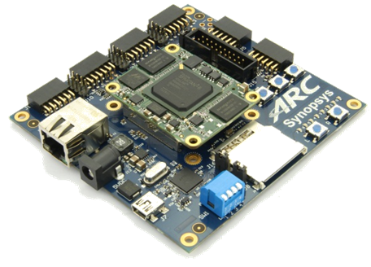
領先創新·
·超越自我
2019 Synopsys ARC盃電子設計競賽

Slide 2
SMART FIREFIGHTER
UETer
UET - VNU

Slide 3
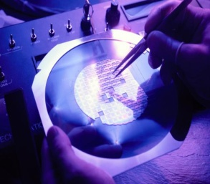
Agenda
Project Overview
System Architecture
Summary & outlook

Slide 4
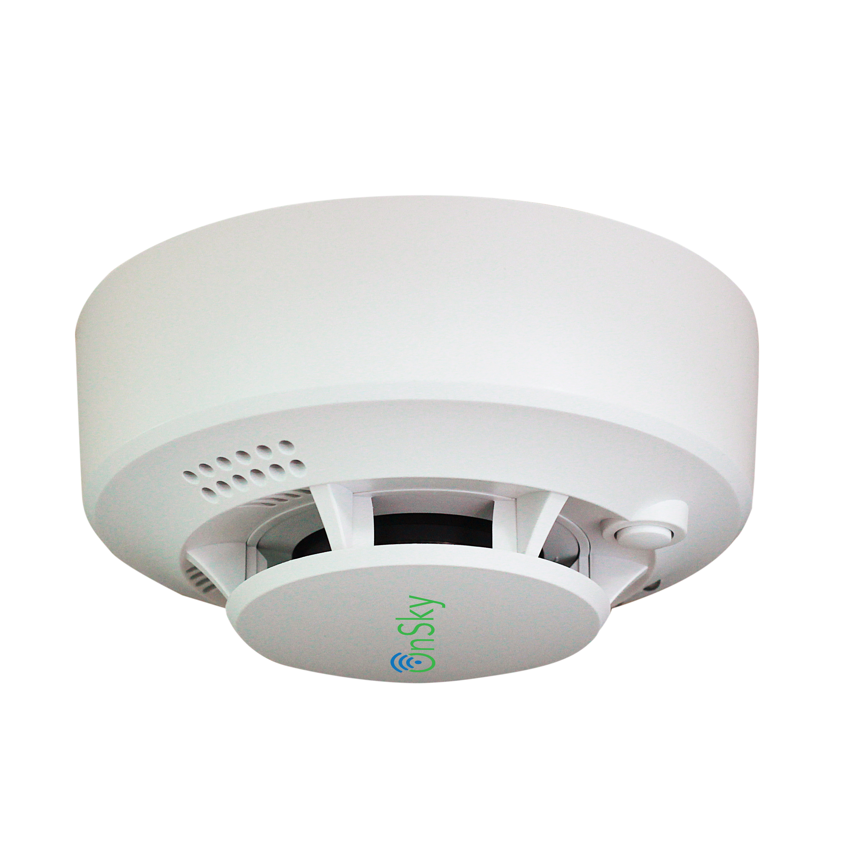
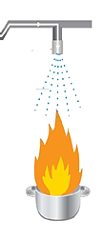
Project Overview
Classic firefighter
Smart firefighter
Quick and accurate detection of flame location.
Detect small size of flame (a candle at 3m).
Spray water flow to the fire correctly, while keeping other areas dry spear.
Can be mobility.
Smoke sensor:
Slow detection
no location of flame
Wide water spray nozzle:
Waste water
Causing damage to other furniture

Slide 5
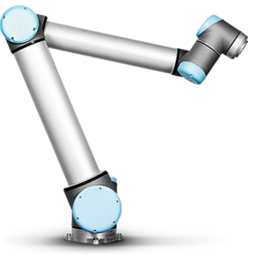
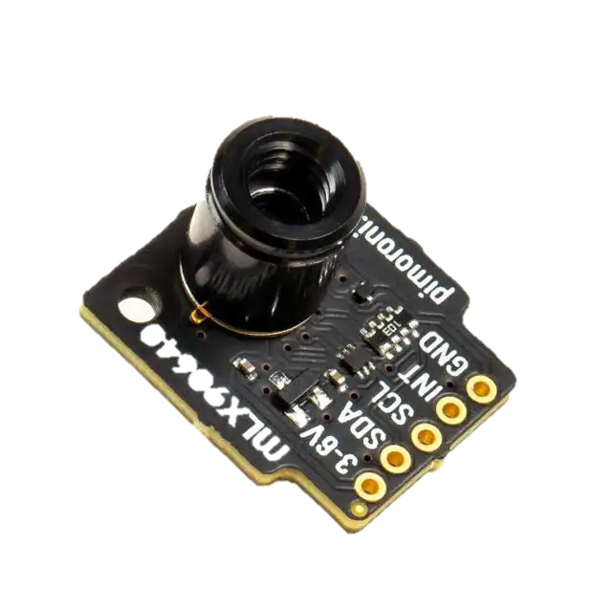
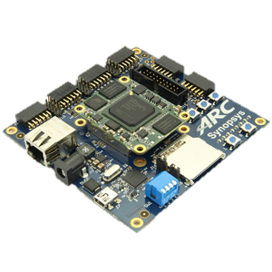

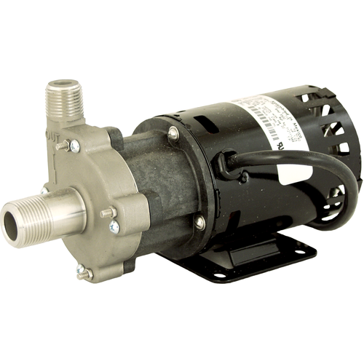
System Architecture
2 stepper motor
UART
Move spray nozzle
Flame directions
2 axis robot arm
UART
H bridge
Flame directions
Spray water
Calculate flame locations
Water pump
2x thermal sensor 32x24 pixel
FOV: 55°x35°

Slide 6
Flame directions - Example
4
3
2
1
-1
-2
-3
-4
 | -4 | -3 | -2 | -1 | 1 | 2 | 3 | 4
Hottest pixel: xh = 2, yh = 1
- x angle: α = (55/32)*xh
Y angle: β = (35/24)*yh
2 sensor: α₁, α₂, β₁, β₂

Slide 7
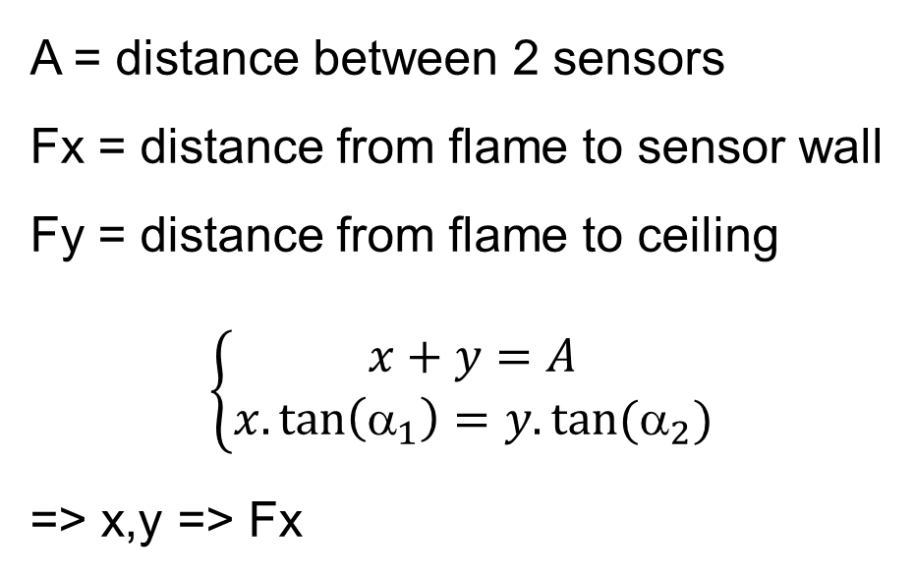
Flame directions
A = distance between 2 sensors
Fx = distance from flame to sensor wall
Fy = distance from flame to ceiling
$$\left\{\begin{matrix}x+y=A \\ x.\tan\left({\text{α}}_{1}\right)=y.tan⁡({\text{α}}_{2})\end{matrix}\right.$$
=> x,y => Fx
x_{v}
y_{v}
Fx
α₁
α₂
x
y
Sensor 1
Sensor 2

Slide 8
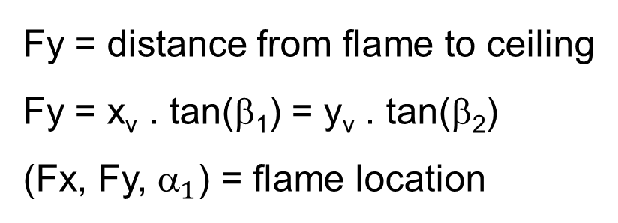
Flame location
Flame
Fy = distance from flame to ceiling
Fy = x_{v} . tan(β₁) = y_{v} . tan(β₂)
(Fx, Fy, ${\text{}}_{1}$) = flame location
Fy
β₁
x_{v}
Sensor 1

Slide 9
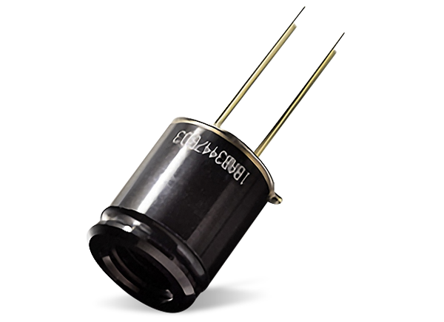
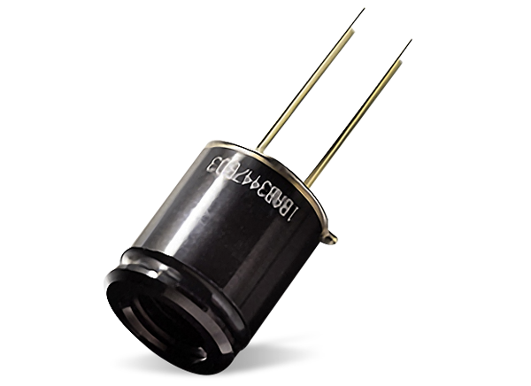
Demo
4m
4.4m
40cm
80cm

Slide 10
Sensor setup
50cm
80cm

Slide 11
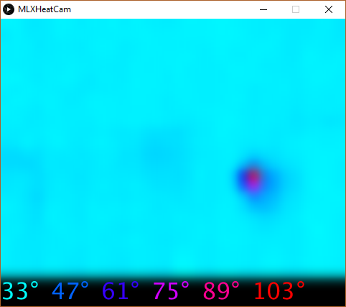
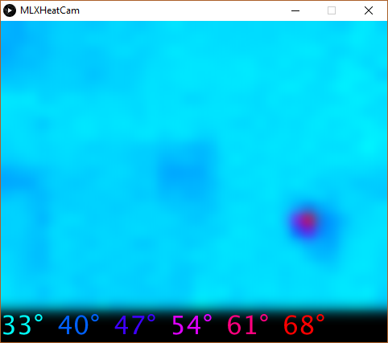
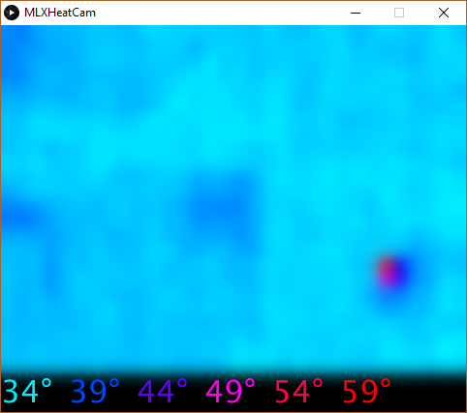
Demo – candle flame
1m
2m
3m

Slide 12
Demo
Cụm sensor đặt trên tripod
Tay robot phun nước đặt dưới sàn
Kit, module điều khiển động cơ, relay đặt trong hộp in 3D, có quạt tản nhiệt
Lửa nến cách 3m
Hiện ảnh nhiệt trên màn hình

Slide 13
Outlook
Mesh Network with Multi Node
Multi sensor node.
Multi water spray
=> Extend protection area.

